Slide 1
SIMPLY CONNECTED the new network means business
Notes:
We’re going to be covering Simply Connected – our integrated portfolio of Enterprise products and how these address the current trends of mobility, access and security

Slide 2
















Major market trends…
Data mobility and scale at an all time high and growing
Mobile Internet
Security
Explosive Growth
Attacker
22 ZB
5.3 ZB
.gov/.com
.me/.you
3.3B
Smartphones Surpassed PCs:
as the Mobile Experience Usurps the Desktop Model
Threats
2.1 B
14 B
120
Million
5 B
90
Target
$148 B
60
30
New Targets
New Applications
$59 B
2009
2011
PCs
Smartphones
2011
2016
* Morgan Stanley
* Gartner
Notes:
The time for enterprise mobility is now. According to IDC, by 2013, more than 1.19 billion workers worldwide will be using mobile technology, accounting for 34.9% of the workforce.*
Mobile Internet just reached an inflection point – taking center stage as desktop computers becomes secondary
The new security landscape
Attacker - - in 2005, we saw a shift in attacker motivation from pursuing notoriety, to profitability. Today, cybercrime is fully organized and we see crime syndicates out to profit from attacks
Threats - While we see new types of attacks we also see the morphing of existing attack types. As an example a few years ago, the majority of malware was in cleartext which could often be detected by AV or IDP solutions. Today over 80% of malware uses encryption, compression or file packing to bypass traditional AV or IDP technologies. We also see a transition of threats with the Web 2.0 trend, through the browsers and traditionally open ports like port 80.
Target - Finally, we also see significant changes with attack targets. Over the past few years there has been an explosion in the volume of data, the devices that attackers target ranging from smartphones, to tablets and to cloud services
The explosive growth in mobility has no signs of slowing down and is driving demand for network innovations.

Slide 3













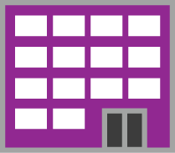




The world is on the move the network can’t stand still
Clients
The Network Becomes a Key Enabler
or Barrier to IT Success
Applications
Mobile
Corp IT
Home
Outsourced
Branch
Ad-Hoc
Chosen
Campus
Assuring Mobile Accessibility
Is Now an Imperative
Notes:
3
Originally, the business premises network was designed to support specific IT owned application from wired ports by using dedicated VLANS for specific tasks. This approach can’t scale to support the mobility storm ahead. Mobility not only changes the way we consume content but also changes the content that is consumed. Traditionally, the data center was responsible for holding the IT owned business applications. Mobility opens the door to deploying outsourced applications like salesforce.com, as well as selecting ad-hoc user applications. Today you’re losing control of access and applications, increasing the importance of the role of the network to IT success.
All content will be delivered through one network. Media rich applications and blurring boundaries between business and private applications will force a shift to an all IP network. With Juniper you can confidently assure mobile accessibility now and in the future.

Slide 4



















































mobility Redefines Business Practices
An Opportunity, Not a Problem
Business Applications
Personal Applications
Pulse
42%
Increased
Productivity
39%
Reduced
Paperwork
37%
Increased
Revenue
Source : Forrester, Frost &Sullivan, Business week, Gigaom pro, ABI research
Notes:
As we discussed, boundaries are blurring between business and personal/private applications. As Enterprises adopt mobility, we see a trend of increasing number of business applications– enhancing business process by leveraging mobility to put the right information in the hands of the user at the right time, making critical decision making faster and more accurate.
Some examples would be CRM access for your sales teams, or Electronic Medical Files heavily deployed and relied upon in hospitals. Talking with customers we have learned that they have redefined their business practices, utilizing mobility, to create competitive advantage and higher end-user productivity.
A good example I like to use is Evernote – an app a lot of people I know have downloaded on their personal mobile devices. It’s not delivered or driven by corporate IT. But employees are bringing it in to the network, and storing senstive data on it.
Why enterprises use APP ?
42% Increased Productivity
39% Reduced Paperwork
37% Increased Revenue

Slide 5





Increased expectations for networks
Unique Daily Wireless Sessions
Large American University ~50,000 Students, Multiple Devices Per Student
6x
Spring
Summer
Fall
Spring
Summer
Fall
2010
2011
Notes:
Global mobile data traffic to grow 26x in next 5 years to over 6M terabytes per month,
Example:
if you take a look at this graph we’ve got right here, I call that the “I” phenomenon. It’s a very large Midwestern university, about 9,000 access points, 300 acres, 50,000 students and you can see in the spring of 2010, about 40,000 wireless sessions per day, a little bit of a lull over the summer break and then come back in the fall of 2010 and more than three times the number of daily wireless sessions. Now look at the Fall of 2011 300000 wireless sessions .
Now, the university didn’t go out and get another 100,000 students. This is students coming back with mobile devices, iPads, that kind of thing.

Slide 6




The solution is to be SIMPLY Connected
An integrated portfolio of resilient wired, wireless and security products that simply enable mobility at scale.
Consistent Security
Performance at Scale
Highly Resilient
Notes:
Addressing these user and IT trends, Juniper has delivered an integrated portfolio of resilient wired, wireless and security products that simply enable mobility at scale, and this is designed to meet both your current and future needs. And we’re going to review now how we do this.
This solution is based on 3 core pillars.

Slide 7
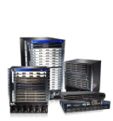


















Simply connected addresses major market needs
Industry’s most comprehensive solution with unified policy and security for BYOD and Mobility
Unified Policy / Security
Industry’s highest performance network
Switching
Wireless
High Performance at Scale
Security
Routing
Industry’s only full automated, uninterrupted network service
Highly Resilient
“All the great things are simple.” - Albert Einstein
Notes:
Review what the partner can sell
Grow your revenue by offering the Simply Connected Solution in an $18B WW TAM in Campus and Branch
Change the conversation with your customer to address the challenges of BYOD, Mobility and network simplification
Increase your deal size and margin by offering a complete differentiated solution with multiple insertion points
Own the customer experience from the data center to the edge device with Juniper Networks
Differentiate yourself with your Services or ours – Education. Professional Services
and Support
Simple to manage and scale for a more profitable business model
The timing is ideal. "The business needs disruption, and the disruptive technologies exist to really change our financial model and our cost structure in a way that for once, is actually consistent with what the business wants -- which is more wood behind the arrow and less wood focused on operations," says Mark McDonald, group vice president for executive programs at Gartner.
There are only two companies today who can provide the complete solutions for a campus network from access through WAN with complete security. Juniper is the only one who can help your customers make the transition to the new network which requires a new perspective on business mobility needs. With Juniper it is possibly to be simply connected.
1.) Mobility to empower business success - Safe and simple mobility while protecting assets
2.) Wired like experience every ware - Scalability without complicating the network
3.) Continuity of rich media app - Automated, uninterrupted service
(NOTE that we need to add to the Simplicity message here)

Slide 8
SIMPLY CONNECTED
Juniper Wireless solution
March 20, 2012
Notes:
We’re going to be covering Simply Connected – our integrated portfolio of Enterprise products and how these address the current trends of mobility, access and security

Slide 9





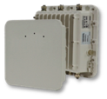











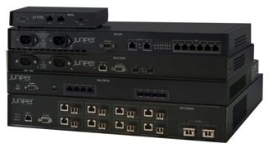
Juniper WL series – WLAN Products
Deployed Extensively
Over 6,000 customers, 1M+ access points
Campus, branch
Healthcare, Education, Hospitality
Fortune 500
Why We Win
High performance and reliability
Easy life cycle management
Simplified, robust security
  Operational Simplicity
Notes:
Juniper offers a complete portfolio of products for an Enterprise Campus Mobility Solution – A highly scalable controller family that enables a unique clustering scheme for the most reliable WLAN with hitless failover; high capacity enterprise class access points for deployments of any size from remote branches to large scale mission critical enterprises; world class management with advance security and full access control .
Juniper’s WLAN Solution has been deployed extensively across many industries including education (higher ed and k-12), healthcare, manufacturing, hospitality and many large Fortune 500 companies like: Shell, Chevron, Alcoa, Audi and VW.
Our installed base exceeds one million Access Points (APs), all installed in mission-critical environments throughout the world
Why we Win -Juniper, owns the largest patent portfolio in the area of mobility, security, resiliency and location services. These technologies are embedded in Junipers leading networking patent portfolio.
Juniper wireless is present in the forefront of defining WLAN technologies and markets.
With Smart Mobile we have pioneered many key innovations in the area of seamless roaming.
We were first with scalable and reliable world class WLAN network management with integrated life cycle management from planning to full deployment and controller virtualization. This greatly simplifies the ever expanding IT tasks to enable mass scale and nonstop wireless deployments
Deeply integrated in Junipers secure UAC solution we provide mobile users secure identity based networking.
This enables mobile users privileges, polices and services and we can track the user’s Wi-Fi enabled devices as they freely roam around.
Operational simplicity sets us apart from other, should be flashed in the end.
Customer examples:
1) University of Minnesota:
Juniper WLAN technology was also chosen by the University of Minnesota (USA) over Cisco for one of the largest 802.11n deployments in the world.
To date University of Minnesota has deployed over 4500 access points and their plan is grow that to close to 10,000 802.11n Access Points by late 2012.
2) Belfast Social Care and Trust:
Juniper Wireless is also deployed (for many years) at the Belfast Health & Social Care Trust
The trust has implemented some of the worlds most innovating WLAN enabled healthcare applications in Europe.

Slide 10

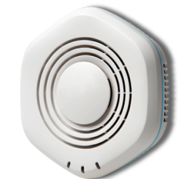
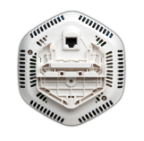
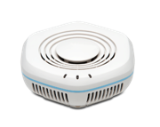
WLA532 Indoor 802.11n AP
Most Compact 11n AP
3x3 MIMO, 3 stream antenna
Integrated antenna design
Highly Integrated
Client Access and Spectrum Analysis
Encrypted, high speed links to Remote Aps
Trusted Platform Module ensures authenticity of HW, SW
Energy efficient
Under 802.3af power limit
Reduces consumption per 802.3az
Notes:
WLA532 is Junipers next generation 802.11n AP. It is our flagship access point with a discreet form factor, superior aesthetics and best in class performance, out performing similar products from other vendors (beats Aruba 135 with 20% better throughput over distance).
WLA 532 is the most compact 3 stream AP on the market. Its refined shape and form factor blends in with most building interiors and its small footprint allows for discreet, safe, easy installations.
It has a revolutionary patent pending cross polarized indoor, integrated antenna design that enhances 5Ghz coverage, improving load balancing across 2.4 and 5 GHz and enables seemless roaming. This dual radio design delivers 20% more throughput and 50% more capacity for multimedia applications and very dense mobile WiFi client environments.
This highly integrated design delivers high value providing concurrent client access and spectrum analysis. Additionally, it supports encrypted, secure high speed links to remote AP deployments. And the trusted platform module ensures the integrity and authenticity of hardware and software.
Energy efficient - Efficient power system design consumes less power than previous generation; it works under 802.3af power draw limit even under peak load and adheres to IEEE802.3az energy efficient Ethernet design to reduce energy consumption when not in use.
TECHNICAL Specs:
Interfaces
Concurrent dual-radio (11an/11gn) operation
Up to 450Mbps link speed on 5GHz
Up to 195Mbps link speed on 2.4GHz
10x better performance than 802.11a/g
802.3af PoE power
Security
Encryption at “air” rate 802.11i, WPA2/AES, WPA/TKIP, WEP
No stored configuration, no serial port, Kensington lock
Performance and Mobility
Local switching for low Latency, high performance
Advanced AP to AP VLAN tunneling
Management
AutoTune Dynamic RF management
Antenna
Six Internal cross-polarized antennas with 5 degree down-tilt for best signal strength
External Antenna model (available Q1)
Usability & Ease-of-Installation
Versatile mounting options for ceiling, wall mount and wall plugs

Slide 11
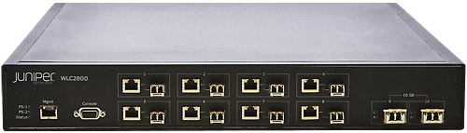
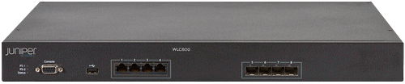
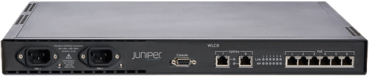
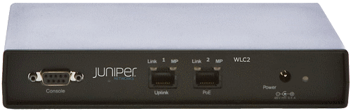
Juniper WLC Series controller family
64 - 512 11n AP
Reliability
in-service upgrades
One software platform
Distributed and centralized
WLC2800
Enterprise
16 - 256 11n AP 3-Stream
WLC Series Highlights
WLC880
16 - 128 11n AP 3-Stream
Campus
WLC800
12 AP
4 AP
WLC8
Branch
WLC2
4
12
16
32
64
128
192
256
512
# of AP
Notes:
< Juniper Wireless: WLC Controller Family >
Introduction Summary:
Juniper provides a complete portfolio of enterprise grade WLAN Controllers.
<Click Once>
Small Deployments: WLC2 and WLC8
The WLC2 supports up to 4 access points and is well-suited for branch office, retail store, and small business deployments.
It can be configure and manage locally or from a remote location with automatic no-touch deployment.
The WLC8 supports up to 12 access points and is designed for branch office and distributed wiring closet installations.
Medium Deployments: WLC200
The WLC200R can scale to support up to 192 access points with flexible licensing bundles of 32 supported access points for optimum price/performance.
It supports demanding wireless applications, such as voice and video over WLAN, for thousands of users at indoor or outdoor locations.
The WLC200 Series can support up to 64 APs in a centralized architecture or up to 192 in a distributed AP architecture.
Large Deployments: WLC800 and WLC 2800
The WLC800 is designed for mainstream 11n deployment at large sites.
It offers 8 Gbps of line-rate switching throughput and supports up to 128 three-stream 802.11n access points with flexible licensing bundles of 16 supported access points.
The WLC2800 is designed for mass deployment of wireless LAN access in large enterprises.
It offers 28 Gbps of switching throughput and supports up to 512 802.11n access and comes with a base license to support 64 with flexible licensing bundles of 64 supported access points.
Technical Summary:
Clusters of up to 64 Juniper Wireless LAN Controllers form a mobility domain, which provides seamless roaming, intrusion protection, and RF management over large, single-site wireless LAN deployments.
A network domain interconnects mobility domains to support multiple sites and span wide geographic regions with secure, seamless mobility applications and smart mobile services.
All Juniper Wireless LAN Controllers enable seamless and secure deployment of enterprise wireless networks over L2/L3 networks without disruption.
These controller are 802.11n-ready and provides intelligent switching, combining centralized and distributed data forwarding.
The WLC series combines L2 Ethernet switching, stateful per-user and per-service firewalls, wireless intrusion protection, 802.1Q trunking and per-VLAN spanning tree (PVST+).
<EOS>

Slide 12
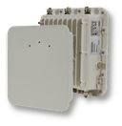
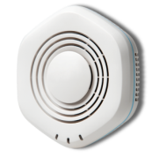
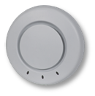

Juniper WLA Series Access Point Family
2Q2012
High performance
Intelligent switching
AP and band steering
Autotune RF management
Built-in spectrum analysis
Bridging and mesh
3 Stream
MIMO
Dual Radio
Max. Performance
3x3 MIMO
Dual Radio
All Weather
WLA Series Highlights
2x2 MIMO
Dual Radio
High Density
Dual Radio
Entry-level AP
Functionality
WLA632
Single Radio
Low Cost AP
WLA532
WLA522
WLA322
WLA321
Entry level 802.11n
Indoor 11n
Outdoor 11n
Notes:
Enterprise-grade Access Point Family
Juniper provides a complete portfolio of enterprise grade Access Points. The Juniper family of APs includes cost effective legacy APs for customers with basic WLAN needs on a tight budget. These include the WLA371 single radio and WLA422 dual radio APs.
Our next generation indoor AP provide customers with a cost effective upgrade 802.11n. The WLA522 dual radio AP with internal antennas. The WLA522E that support external Antennas for greater distances an versatility. These APs are designed with two transmitters and two receivers referred to as 2x2 MIMO AP. The WLA522 and WLA522E are best suited for high density indoor deployments. This AP includes HW accelerator for higher CAPWAP data path crypto performance (about 40 to 50% of no crypto) and more importantly HW assisted Spectrum Analysis capabilities.
The WLA532 has three transmitters and three receivers and is know as a 3x3:3 Spatial Stream MIMO AP. It has dual Radio AP dual internal radios and delivers 50% more performance and capacity as well as 10% to 15% greater range than the WLA522. This allows for more capacity and coverage area per AP and is best suited for large enterprises with very high density of users.
The WLA632 is a dual radio 3x3 MIMO 802.11n AP for outdoors with several Antenna options that allow for ranges up to 5 miles or 8 Kilometers with the highest gain direction antenna.
Note: All of our dual radio APs support multi-hop mesh and wireless bridging features. Mesh and Bridging features are sold as separate licenses for the controller the AP is associated to.

Slide 13
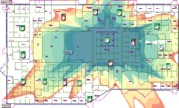

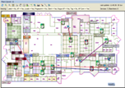
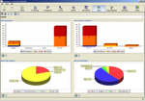

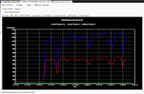
Juniper WLM Series Life Cycle Management
Planning and deployment
3D predictive planning tool
Indoor and outdoor network plan
Configuration and Verification
Complete offline configuration
System and service wizards
Pushes configuration to WLCs
Monitoring and reporting
By user, radio, AP, WLC, SSID
30 day history aids compliance
WIDS/WIPS integration
Location aware
Search by location
Roaming history
Geo fencing
RingMaster
Plan
Config
Monitor
Trouble
shoot
Report
Notes:
< RingMaster: Best in Class WLAN Lifecycle Management >
RingMaster is a fully integrated lice cycle management tool.
It guides the customer through planning based on parameters such as capacity, coverage as well as attenuation factors.
These factors are various kinds of building materials and height of the AP deployment.
AP configuration data from planning (such as power, channel and controller association) is automatically passed to the configuration aspect of the life cycle.
Configuration in RingMaster is easy with the use of wizards to config, policy management, flexible deployment and upgrade.
It includes an automated CLI/RM reconciliation and audit trailing are some of the highlights of the RM configuration.
RM also provides the ability for the users to copy paste configuration elements from one controller to another.
It also support the ability to bulk import APs for the greatest ease of use in larger environments.
RingMaster delivers excellent floor level, equipment level (from deployment level down to each individual radio) and SSID level monitoring.
Client monitoring and troubleshooting and security (WIPS/WIDS, rogue detection) are all driven from intuitive dashboards.
The whole monitoring section is location aware.
Wireshark integration, queue depth analysis per client, location vs. RF connection and historical data for voice and data sessions provide excellent client level troubleshooting.
Reports in RingMaster cover the entire gamut of planning, configuration and monitoring information in RingMaster. Reports can be generated in pdf and html formats.
They can be emailed, stored on the RM server or FTP’d to a separate server for archival. All reports can be scheduled.
Reports include historical traffic, top traffic / load hot spot information, session / client related reports, PCI report, security related reports etc
<EOS>

Slide 14
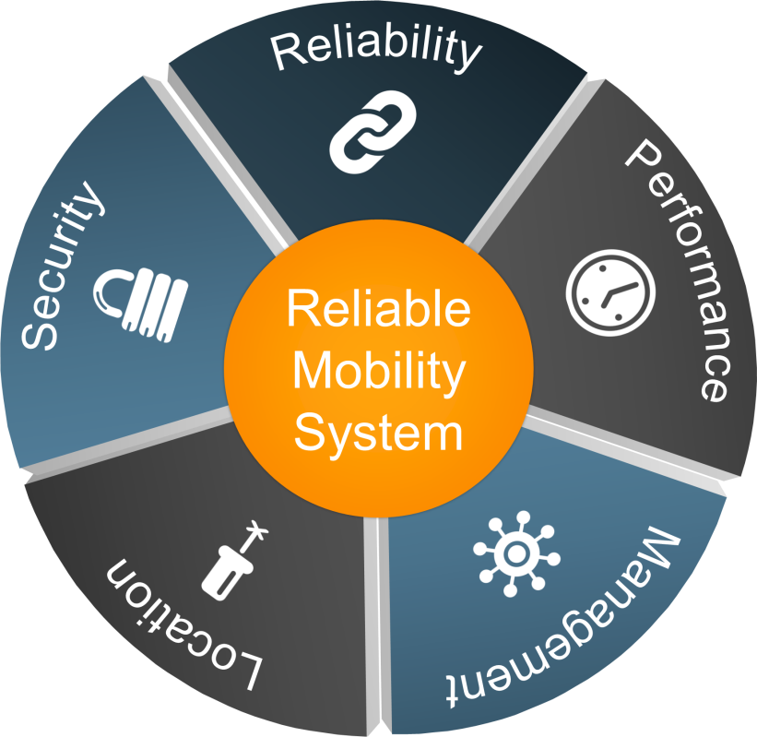
THE STRONGEST FOUNDATION
FOR MOBILITY SERVICES
LAN
WLAN
Nonstop mobility services
  Unmatched reliability
  Leading management
  Comprehensive security
  Superior performance
  Location awareness
Simple
Simplify the most important WLAN functions
Secure
Focus on security capabilities that really matter
Mobile
Design mobility into the heart of the network
Notes:
Juniper’s wireless network value proposition is build on the following fundamentals: Simplicity, Reliability and Scalability. The following technology innovations, unique to Juniper wireless, enable the Simple, Reliable and Scalable mobile experience:
• Simplicity - Delivered by Juniper with Ringmaster and Unified Mobility Services
• Reliability - Delivered by Juniper through Virtual Controller Clustering
• Scalability - Delivered by Juniper through Distributed Forwarding and Identity Based Networking
14

Slide 15





SINGLE POINT OF MANAGEMENT
FOR ALL CONTROLLERS
LAN
WLAN
Primary Seed
Secondary Seed
Member
Member
Member
Notes:
What is a Cluster?
A set of controllers grouped into a single logical entity
Cluster provides 3 main functions:
High availability – all APs in a cluster maintain 2 active connections to different members of a cluster. If one of the controllers fails, the AP uses the second controller to remain in service
[competitive] – no other solution provides this level of resiliency
Single Point of Config – One controller in the group serves as the coordinator for the cluster. All configuration is performed on the seed device and the seed propagates changes to other controllers in the cluster
[competitive] – other solutions require config changes be performed on every device in the wlan system.
AP load balancing – All APs joining the cluster are assigned to member controllers by the seed device. The seed optimizes the distribution of the APs to create equal load on all devices in the cluster
[competitive] – no other solution supports the automatic distribution of APs among controllers

Slide 16













Automatic Client Load Balancing
EX Series
WL Series
  Automatic Load Balancing per RF Band
  Band Steering
5 GHz capable client ‘encouraged’ to connect at 5 GHz
2.4 GHz only client connects at 2.4 GHz

Slide 17



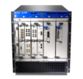

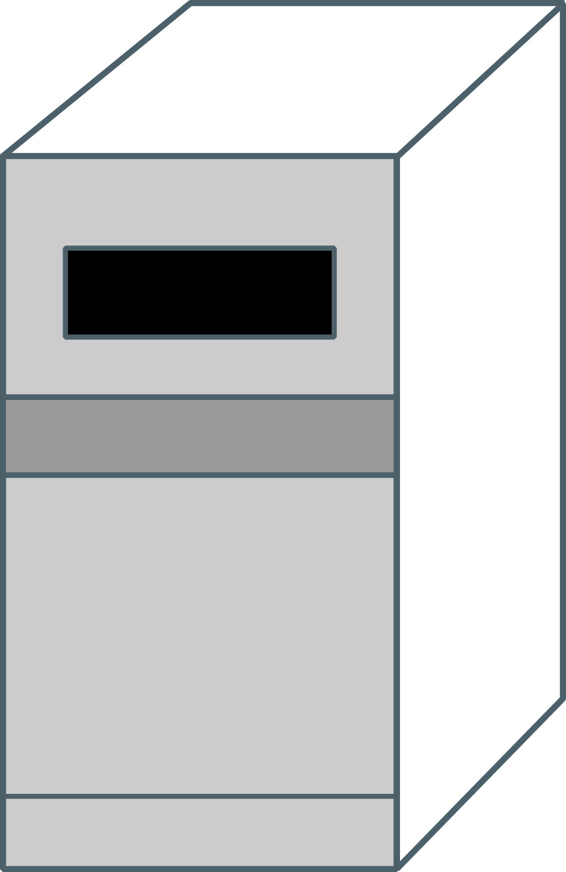







SMART MOBILE ARCHITECTURE
(CENTRALIZED & DISTRIBUTED)
EX Series
WL Series
  Centralized
  Distributed
Security Management
Reliability Performance
  Or both combined/mixed
  (can be decided per VLAN)

Slide 18


Active-active controllers
EX Series
WL Series
2
  Primary controller
  authenticates/
  authorizes client
3
  Primary propagates session details to backup controller
  for use during failure
Primary Seed
Client
Session
State
Secondary Seed
Member
Member
Member
Client
Session
State
1
  A new client associates
  to the system
Notes:
a new client associates to the system
primary controller authenticates/authorizes client
primary propagates session details to backup controller for use during failure

Slide 19
SELF-REPAIRING CONTROL ARCHITECTURE
EX Series
WL Series
1
  Should the Primary be
  taken out of service, the Secondary immediately takes over
Primary Seed
Secondary Seed

Member
Member
Member
Notes:
a new client associates to the system
primary controller authenticates/authorizes client
primary propagates session details to backup controller for use during failure

Slide 20

Nonstop operation
EX Series
HITLESS
FAILOVER
2
  A new Secondary is
  designated and is given the
  AP configuration and
  client session state
Primary Seed
Secondary Seed
Member
Member
Notes:
High availability – all APs in a cluster maintain 2 active connections to different members of a cluster. If one of the controllers fails, the AP uses the second controller to remain in service
[competitive] – no other solution provides this level of resiliency.
Single Point of Configuration – One controller in the group serves as the coordinator for the cluster. All configuration is performed on the seed device and the seed propagates changes to other controllers in the cluster
[competitive] – other solutions require config changes be performed on every device in the WLAN system.
AP load balancing – All APs joining the cluster are assigned to member controllers by the seed device. The seed optimizes the distribution of the APs to create equal load on all devices in the cluster
[competitive] – no other solution supports the automatic distribution of APs among controllers.

Slide 21
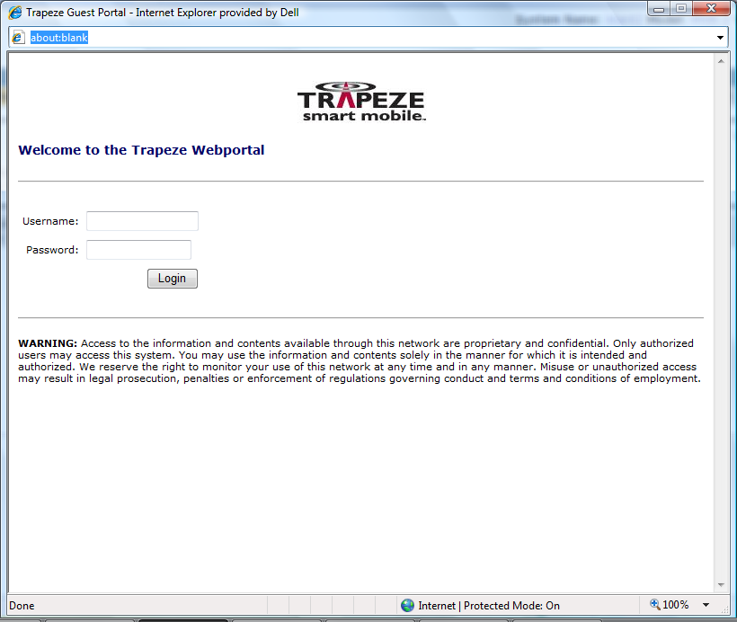

SmartPass – Access Control
WL Series
SmartPass is a multi-faceted web-based, access control application suite
  Guest access module
    Ease of use / Bulk user creation
    API for 3rd part application integration
    SMS / Email creation of guest coupons with
    Self-Provisioning
  Accounting database
    Detailed client accounting history
    Reporting available via RingMaster.
  Access control module
    RFC 3576 support to change authorization attributes or disconnect client sessions (Dynamic Radius)
    Location awareness for client sessions.
      Allow or deny access based on location
      Change any AAA attribute based on location
    Access Rules (location based, time based or a combination of both)
Centralized Guest Access Database
Notes:
21

Slide 22
SIMPLY CONNECTED
Elements of a Simply connected Campus
March 20, 2012
Notes:
We’re going to be covering Simply Connected – our integrated portfolio of Enterprise products and how these address the current trends of mobility, access and security

Slide 23
Simply connected addresses major market needs
Industry’s most comprehensive solution with unified policy and security for BYOD and Mobility
Unified Policy / Security
Industry’s highest performance network
Switching
Wireless
High Performance at Scale
Security
Routing
Industry’s only full automated, uninterrupted network service
Highly Resilient
“All the great things are simple.” - Albert Einstein
Notes:
Review what the partner can sell
Grow your revenue by offering the Simply Connected Solution in an $18B WW TAM in Campus and Branch
Change the conversation with your customer to address the challenges of BYOD, Mobility and network simplification
Increase your deal size and margin by offering a complete differentiated solution with multiple insertion points
Own the customer experience from the data center to the edge device with Juniper Networks
Differentiate yourself with your Services or ours – Education. Professional Services
and Support
Simple to manage and scale for a more profitable business model
The timing is ideal. "The business needs disruption, and the disruptive technologies exist to really change our financial model and our cost structure in a way that for once, is actually consistent with what the business wants -- which is more wood behind the arrow and less wood focused on operations," says Mark McDonald, group vice president for executive programs at Gartner.
There are only two companies today who can provide the complete solutions for a campus network from access through WAN with complete security. Juniper is the only one who can help your customers make the transition to the new network which requires a new perspective on business mobility needs. With Juniper it is possibly to be simply connected.
1.) Mobility to empower business success - Safe and simple mobility while protecting assets
2.) Wired like experience every ware - Scalability without complicating the network
3.) Continuity of rich media app - Automated, uninterrupted service
(NOTE that we need to add to the Simplicity message here)

Slide 24








1.Consistent security bringing control back to IT
Qualify the Device
Branch
1
Provision and Authenticate the User
AP
EX
SRX
2
Campus
Enforce Security Policies in the User and Application Level
3
MX
MX
Control the Device and Avoid Data Leakage
MAG
SRX
4
Device, Network and App Security
Security context and coordination
Freedom
to choose
and change
WLC
EX
AP
Servers
Notes:
End to End security
1. Qualify the Device :
With Juniper simply connected solution you can scan the device to make sure all the credentials that are needed to on board the device to your network are up-to-date. You will be
able to force an update if needed, and quarantine the device until it is compliant. This is automatically performed by Juniper MAG and pulse.
2. Authenticate the User
There are two side effect to consumerization of IT:
One is a shift to multi devices per one user with a mix of corporate and privately own.
The second is that the user will try to connect to the corporate network from any location he is in.
To get control back you will need to shift from securing your network by ports and location to secure your network by users and applications, assigning relevant polices to support the user responsibilities and the business needs.
With juniper simply connected we make it easy for Enterprises to build this user centric data base importing their existing information to the centralized policy platform. Unified access control (MAG/UAC) is orchestrated for a wired or wireless clients accessing the network.
3. Enforce Security Policies in the User and Application Level
Now that we have an approved device with user and application based security policies, we need to have the ability to enforce it in the network.
Juniper MAG/UAC will populate the policies to all elements in the network delivering consistent enforcement and ensuring access to the right content from any location. Remote workers will be authenticated through MAG/SSL.
With fast pace attackers today, you need fast pace enforcement. The SRX Series Services Gateway includes zero-day protection. In particular, it includes protocol anomaly detection and same-day coverage for newly found vulnerabilities. Additionally, through scheduled security updates configurable by the network security administrator, the SRX gateway can automatically be updated with new attack objects/signatures. Therefore, up-to-the-minute security coverage is provided without manual intervention.
4. Control the Device and Avoid Data Leakage
We have an approved device and approved user on the network, working in conjunction with the business needs and capabilities.
You will find that the customer may now have concerns around data leakage from lost devices. And no wonder,
“ In London more than 30,000 mobile phoned are left behind in taxis every day “
With Juniper solution you can control the mobile device whether it is corporate or privately owned. In a case of lost or stolen device you will be able to track the device location, lock , copy and wipe all corporate data remotely .
Simply connected Brings the control back to the corporate

Slide 25
2. Performance and scale simple & cost-Effective scaling
Wired-like
Performance Everywhere
Branch
1
Designed for Bandwidth
Hungry Rich-Media Applications
AP
EX
SRX
2
Campus
No Performance Tradeoffs
as Campus Scales
3
MX
MX
MAG
SRX
Low Latency & Increased Throughput
Optimized Distribution of Traffic on APs
Protection for High Priority Sessions
WLC
EX
AP
Servers
Notes:
Wired-like Performance Everywhere:
User moves within campus, gets on mobile n/w, logs on from a branch location– seamless experience as he/she moves – feels like always connected to a wired connection at his/her desk. 802.1n AP’s (talk about new WLA532). (Talk about 10GE uplinks on all switches). (Talk about 4 member VC on EX8200 is an industry differentiator)
Designed for Bandwidth Hungry Rich-Media
Voice, video. Data traffic across both the wireless and wired access, core switches and security devices. You need large tables and buffers to ensure bursty video traffic can be streamed on mobile devices.
3. No Performance Tradeoffs as Campus Scales
No tradeoffs between scale and performance as you change and evolve your campus. So, more locations, more users, more apps – same IT budget!
Talk about
WLC : Protection for high priority sessions, AP load balancing – optimizes the distribution of the traffic on APs to re-allocate of sessions among APs in order to flex and adapt to stresses without dropping sessions
EX : Provides multi hops though the VC reducing latency and increasing throughput . VC/stacking with GE/10GE fiber downlinks
SRX : Reduces the load on the network by only forwards legitimate traffic
MAG SSL : Application Acceleration

Slide 26


3. Highly resilient
FOR Non-stop productivity
Designed for
Mission-Critical Networks
Branch
1
Layers of Protection
for Planned and
Unplanned Outages
AP
EX
SRX
2
Campus
Simplified Operations
3
MX
MX
MAG
SRX
80% Fewer Managed Devices
Carrier Class Network for Enterprise
No Single Point of Failure
WLC
Servers
EX
AP
Notes:
Designed for Mission-Critical Networks: Enterprise tested , SP proven
Redundant components, power supplies, software protocols
EX &WLC : In-Service Software Upgrades allowing for 24/7 operation
2. Layers of Protection for Planned and Unplanned Outages : No single point of failure- animation
MAG : MAG support application clustering on one box with hardware redundancy
SRX : SRX clustering - no single point of failure . WAN backup using ETH, xDSL, 3G/4G
WLC : controller clustering -> all AP in a cluster maintain two active connections
EX virtual chassis - Robust design->no single point of failure and superior backplane capacity, Zero Impact Network Fail Over
With the combination of MAG & PULSE you will be able to restore content from a stolen or lost device and placed it easily on a new hardware delivering resiliency all the way to the user device.
3. Simplified Operations, simplified wired and wireless, less devices, more automation. Mobility improves business process and not only to support BYOD
No Moore’s law for network management costs. You cannot reduce the number of devices but can certainly reduce the number of devices to manage. This is where Juniper is focused and different from all other solutions.

Slide 27
SIMPLY CONNECTED
A day in the life of a simply connected user
March 20, 2012
Notes:
We’re going to be covering Simply Connected – our integrated portfolio of Enterprise products and how these address the current trends of mobility, access and security

Slide 28







The goal is to be SIMPLY Connected
Simplified switching architecture, now a complete, feature-rich portfolio
Wired-like experience on wireless – resiliency and performance
Simple for users
Simple for IT
Superb QoE
Highly economic
Integrated security
Always on resiliency
High performance
Simplified architecture
Automation
EX Series
WL Series
SRX Series
Security follows user, and application intelligence
Device-agnostic secure connectivity
Notes:
The goal is to be Simply Connected, simple for users, simple for IT, providing superb QoE at high level of economics. How do we do that? We are offering a portfolio of products working together, solving the problems we discussed. We will talk today about integrated security, always on resiliency, high performance, simplified architecture and automation, all means for delivering on the promise.

Slide 29






THE SIMPLY CONNECTED story
  A DAY IN THE LIFE
  of a simply connected user
  We will show you how a Juniper network manages voice and video calls from
  non-company owned devices and how our
  WL and EX series provide a uniquely resilient environment for the mobile user
  We will detail some of the key differentiating technologies that we have to offer for wireless and ethernet switching
  Our technical experts are standing by to take your detailed technical questions on any of the material presented at the end of this seminar
29
Copyright © 2010 Juniper Networks, Inc. www.juniper.net
Notes:
Today we will give you a quick run through of how this works, and take a look under the hood of how our unique technologies allow you to solve these problems.
We will follow the progress of an employee named A.J. as he arrives at work, gets on a conference call on his Android phone and starts a video session on his iPad. At each point where the Juniper network does something unique, we will provide a technical dive into that particular area. This seminar will give you a look under the hood of how our wireless LAN and Ethernet switches keep your network going under all sorts of conditions.

Slide 30



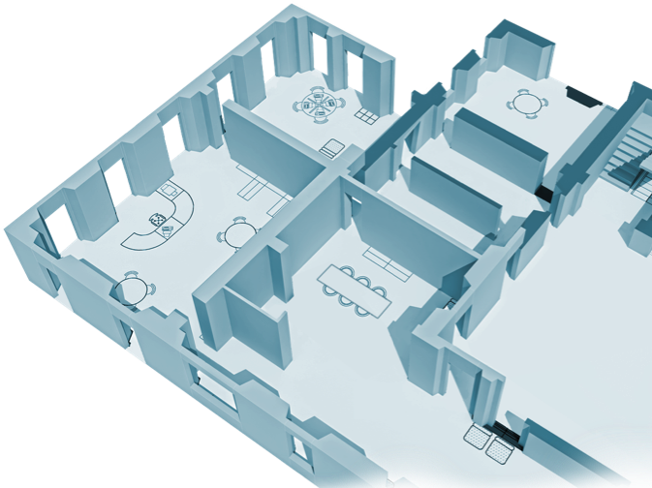




Network
SIMPLY CONNECTED
Coordinated Threat Control
Wireless – scalability, simplicity, automation
Next – managing congestion
✓
✓
  1
Notes:
In order to get a good idea of what a juniper wired – less network does, let’s see what happens to A.J.’s voice and video sessions during a typical day. We will look at all the things that go on under the hood so that A.J. can be Simply Connected.
Let’s start as A.J. walks into the lobby of his building. He is a little late so he doesn’t have time to get to his office to start his work. He turns on the phone and the iPad in the lobby and both devices associate with the wireless LAN. The first thing that has to happen is authentication, so that A.J. is permitted to use the network resources. Additionally, the network needs to register and monitor his sessions for security purposes.

Slide 31















Overview – Coordinated threat control
Wireless LAN
Controller
Active Directory/
LDAP
Data
Junos
Pulse Client
Router
IPS
Firewall
SRX
Router/Firewall/IPS
Wireless AP’s
Finance
Ethernet access
switches
Ethernet core
switches
Video
Universal
Access
Control
RADIUS
Apps
SSLVPN
Corporate Data Center
MAG
Internet
Notes:
This is a view of the functional components of a network on ramp. You need to have access points for the wireless LAN, an Ethernet switch with PoE for the access point to attach to, a network core which connects to the data center and the business applications. Typically a network would have the following individual appliances for the on ramp: firewall, Intrusion Detection (IDP) SSLVPN appliance, Radius server and Access control. Juniper combines these functions into just two platforms. The SRX functions as a router, a firewall and an intrusion detection system. The MAG platform functions as an SSLVPN, Radius server and access policy engine. So the on ramp has just a few devices which make it simpler for management.

Slide 32
Network
SIMPLY CONNECTED
Coordinated Threat Control
Wireless – scalability, simplicity, automation
Next – managing congestion
✓
✓
  1
Notes:
In order to get a good idea of what a juniper wired – less network does, let’s see what happens to A.J.’s voice and video sessions during a typical day. We will look at all the things that go on under the hood so that A.J. can be Simply Connected.
Let’s start as A.J. walks into the lobby of his building. He is a little late so he doesn’t have time to get to his office to start his work. He turns on the phone and the iPad in the lobby and both devices associate with the wireless LAN. The first thing that has to happen is authentication, so that A.J. is permitted to use the network resources. Additionally, the network needs to register and monitor his sessions for security purposes.

Slide 33



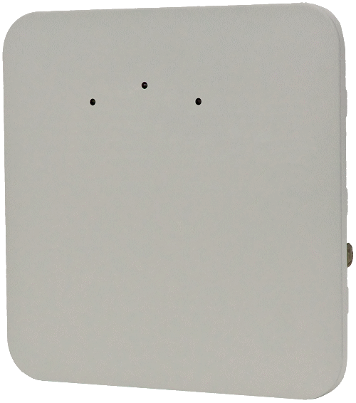


COMPONENTS OF A Wireless LAN (WLAN)
Access Point
WLAN Controller
WLAN Management
Wireless LAN CONTROLLER (WLC)
WLAN
Management
Campus
Core
Firewall
MAG
Encrypted
Access
(Location)
WLM1200
802.1x
Authentication
Trusted
Client
Notes:
Key differentiated technologies for Juniper WLAN
1. Clustering – 32 controllers and 4096 AP’s can be managed as 1 IP address. ADVANTAGE – management simplicity
2. Auto-distribution of AP’s – AP’s are assigned to controllers without network manager intervention. ADVANTAGE – management simplicity
Components of a Wireless LAN
-the WL solution is a controller-led architecture, no standalone AP
-solution consists of indoor/outdoor AP, controllers and management
Access Point
Access Point
Connection point for wireless clients to get on network
Single/Dual Radio
Houses transceivers (radio component)
Converts 802.11 to Ethernet traffic
ACL and QoS enforcement
Powered by PoE
WLAN Controller
Keeps network configuration
Mobility Domain mgmt
Aggregation point for WLAN traffic from AP’s
Switches traffic between wireless clients and wired network
AP management (Images, client load)
Seamless roaming
RF Mgmt (Channel and Power Tuning)
Security (WIDS/WIPS, ID based networking)
WLAN Management
Network & RF planning and configuration
WLAN Network Monitoring
Alerts/Events
Network Map
Troubleshooting
Customized Reports

Slide 34
Single point of management for all controllers
Primary Seed
Secondary Seed
Member
Member
Member
Notes:
The Juniper WLAN offering provides a very simplified architecture due to embedded intelligence in the controllers.
Up to 32 controllers can be managed as a single entity with a single point of management. Because there is a hierarchical organization of the controllers, the network manager only has to manage and provision the master controller. It then organized the rest of the cluster. This saves you a great deal of time for initial set up and during any adds/moves/changes that may occur. The controllers intelligently manage the APs so that you do not have to do that either.
………………………………………
What is a Cluster?
A set of controllers grouped into a single logical entity
Cluster provides 3 main functions:
High availability – all APs in a cluster maintain 2 active connections to different members of a cluster. If one of the controllers fails, the AP uses the second controller to remain in service
[competitive] – no other solution provides this level of resiliency
Single Point of Config – One controller in the group serves as the coordinator for the cluster. All configuration is performed on the seed device and the seed propagates changes to other controllers in the cluster
[competitive] – other solutions require config changes be performed on every device in the wlan system.
AP load balancing – All APs joining the cluster are assigned to member controllers by the seed device. The seed optimizes the distribution of the APs to create equal load on all devices in the cluster
[competitive] – no other solution supports the automatic distribution of APs among controllers

Slide 35
How the cluster adds a new controller
2
1
  The seed pushes the configuration to the
  new member
  The primary controller
  pushes configurations to the secondary seed and members
Primary Seed
Secondary Seed
Member
Member
Member

3
Member
  When a member is removed
  and replaced the same
  process is used
Member
Notes:
a new controller is added to the cluster; the controller contacts the seed; the seed pushes configuration to the new member (see animation)
when a member is removed and replaced the same process is used
when primary seed is removed; secondary takes over responsibility for the cluster (automatic); when the seed device comes back, the secondary will automatically re-sync with primary (automatic)
if there is any new configuration on secondary operator has a choice to force sync with primary (config option)
a new primary seed can receive configuration from secondary when it joins the cluster (config option)
a user can optionally permanently promote the secondary seed to primary via configuration

Slide 36
How the cluster adds a new Ap
2
  The Primary Seed sends AP config to the Primary controller and the AP sets up a connection
1
  A new AP is introduced and contacts the Primary Seed.
Primary Seed
Secondary Seed
Member
Member
Member
3
Member
  The Primary Seed sends AP config to the Secondary controller and the AP sets up a connection
Notes:
a new controller is added to the cluster; the controller contacts the seed; the seed pushes configuration to the new member (see animation)
when a member is removed and replaced the same process is used
when primary seed is removed; secondary takes over responsibility for the cluster (automatic); when the seed device comes back, the secondary will automatically re-sync with primary (automatic)
if there is any new configuration on secondary operator has a choice to force sync with primary (config option)
a new primary seed can receive configuration from secondary when it joins the cluster (config option)
a user can optionally permanently promote the secondary seed to primary via configuration

Slide 37
How clients are assigned primary and secondary controllers
2
  Primary controller
  authenticates/
  authorizes client
3
  Primary propagates session details to backup controller
  for use during failure
Primary Seed
Client
Session
State
Secondary Seed
Member
Member
Member
Client
Session
State
1
  A new client associates
  to the system
Notes:
when a primary controller fails, command is immediately transferred to the secondary controller
-when the primary controller comes back on-line, operator has a choice to force re-sync of config
hitless failover works by mirroring a session record on a backup controller
this includes user details, policy and data path plumbing (tunnels, fdb entries, etc) required to support a user if the primary controller fails the "shadow" copy remains in a dormant state until a failure occurs

Slide 38





Network
SIMPLY CONNECTED
Coordinated Threat Control
Wireless – scalability, simplicity, automation
Next – managing congestion
✓
✓
  1
  2
Notes:
Before we go to the next steps, we have reviewed so far on-ramping to the network with BYOD and how coordinate threat control is addressing associated challenges, and reviewed fundamentals of the wireless technology. Now its time to look at congestion management.
As A.J. walks through his building, he passes a large, open conference room that is full of people. They are all using wireless devices and doing their email. Is A.J in danger of losing his call or his video due to the vampire nature of a room full of wireless users? No.

Slide 39







WiFi Multimedia Access Categories
  Packet prioritization applied to tunneled traffic
  AP and controllers
  classify and mark user traffic
  Wired priority is mapped to 4 X WMM access categories for over-the-air QoS
Notes:
In order for high priority sessions to be maintained, there must first be a marking or classification of sessions so that the WLAN system knows which ones take precedence when choices must be made.
The standards body gave us 11e, WFA called it Wifi MultiMedia.
Important related pieces of WMM are TSPEC (Transmission Specification) for bandwidth reservations, and U-APSD (Unscheduled Automatic Power Save Delivery) for advanced power saving
this provides over-the-air QoS using similar language controls as the wired network
3 types of bandwidth controls in the WL system (strict user limits, strict SSID limits and per-SSID weighting)
No BrVoice packets marked for priority treatment
At L2 using 802.1P class of service (CoS) 6 or 7
At L3 using diffServ expedited forwarding per-hop behavior (PHB 46)
Voice packets marked for priority treatment
At L2 using 802.1P class of service (CoS) 6 or 7
At L3 using diffServ expedited forwarding per-hop behavior (PHB 46)

Slide 40



Dynamic Call Admission Control
  8 voice devices
  associated but idle
  2 active calls
  New client
  session accepted!
  Roaming user
  session accepted!
  Roam accepted
  call preserved!
Notes:
The purpose of bandwidth control is to allow the setting of bandwidth limits to ensure reliable access
There are three methods for controlling bandwidth:
Maximum bandwidth per SSID
Configured limit is full duplex in units of Kbps
Maximum bandwidth per User
Full-duplex rate limit for aggregate of all packets through a client
Weighted fair queuing per Radio Profile
Service-profiles compete for transmit opportunities based on the configured weights
Bandwidth limits are defined in a QoS profile
A VSA allows QoS profiles to be dynamically assigned
with visibility into call setup and status, system can perform Call Admission Control based on active calls as users "roam-in" to a fully loaded AP, the WL system will allow the roam but demote the priority on the traffic until space is available

Slide 41







Automatic Client Load Balancing
  Automatic Load Balancing per RF Band
  Band Steering
5 GHz capable client ‘encouraged’ to connect at 5 GHz
2.4 GHz only client connects at 2.4 GHz
Notes:
Client Load Balancing
AP’s maintain awareness of "rf neighborhood" based on neighboring Aps and client location, AP determines a target loadthe system uses various techniques to "coax" clients to less loaded AP’s. If devices are persistent the system will allow them on.
if an AP detects a client on both 2.4Ghz and 5Ghz bands, the same techniques are used to "coax" a client to less loaded band
The purpose of bandwidth control is to allow the setting of bandwidth limits to ensure reliable access
There are three methods for controlling bandwidth:
Maximum bandwidth per SSID
Configured limit is full duplex in units of Kbps
Maximum bandwidth per User
Full-duplex rate limit for aggregate of all packets through a client
Weighted fair queuing per Radio Profile
Service-profiles compete for transmit opportunities based on the configured weights
Bandwidth limits are defined in a QoS profile
A VSA allows QoS profiles to be dynamically assigned

Slide 42
Network
SIMPLY CONNECTED
Coordinated Threat Control
Wireless – scalability, simplicity, automation
Managing congestion
Next – Simplifying the wired network
✓
✓
  1
  3
  2
Notes:
Having looked at on-ramping to the network and some significant capabilities in wireless and security, let’s see what happens when AJ moves on, roaming to yet another AP, this time connected to a different switch, still within the same virtual chassis. But first, what is a virtual chassis, and what are the main advantages it provides?

Slide 43





Virtual Chassis
Simplifying the network
  Virtual Chassis
  Multiple switches acting as
  a single, logical device
  One switch to configure,
  one switch to manage
  Improved resiliency
  and performance
Notes:
There are three main reasons why Virtual Chassis is a tremendous network simplification tool:
This technology allows to aggregate multiple switches (up to 10) into one single logical device.
Switches that are virtualized together can now be managed as one single elements, simplifying the number of switches to manage by a factor of up to 10.
Once switches are virtualized together using Virtual Chassis, the network is more resilient with no single point of failure in the Virtual Chassis.

Slide 44


Network
SIMPLY CONNECTED
Coordinated Threat Control
Wireless – scalability, simplicity, automation
Managing congestion
Simplifying the wired network
Next – hitless failover
  4
✓
✓
  1
  3
  2
Notes:
As AJ starts to climb the stairs to his office, a forklift operating in the storage area (which houses a switch and a WLAN controller) accidentally skewers both one of the EX4200’s and the Wireless LAN controller attached to it. OOOPS!
When the network manager notices the outage, he realizes that he will have to replace both the switch and the controller. As long as he is making changes, he might as well institute the software upgrade for the Wireless LAN system at the same time.
He gets his spares from the equipment locker and goes to replace the units. (after having a few choice words with the maintenance supervisor). When he replaces and reattached the units, they come up seamlessly and immediately start to pick up the traffic that has been rerouted to other switches and AP’s.

Slide 45
Active-active controllers
2
  Primary controller
  authenticates/
  authorizes client
3
  Primary propagates session details to backup controller
  for use during failure
Primary Seed
Client
Session
State
Secondary Seed
Member
Member
Member
Client
Session
State
1
  A new client associates
  to the system
Notes:
a new client associates to the system
primary controller authenticates/authorizes client
primary propagates session details to backup controller for use during failure

Slide 46
Self-repairing control architecture
1
  Should the Primary be
  taken out of service, the Secondary immediately takes over
Primary Seed
Secondary Seed

Member
Member
Member
Notes:
a new client associates to the system
primary controller authenticates/authorizes client
primary propagates session details to backup controller for use during failure

Slide 47
Nonstop operation
HITLESS
FAILOVER
2
  A new Secondary is
  designated and is given the
  AP configuration and
  client session state
Primary Seed
Secondary Seed
Member
Member
Notes:
High availability – all APs in a cluster maintain 2 active connections to different members of a cluster. If one of the controllers fails, the AP uses the second controller to remain in service
[competitive] – no other solution provides this level of resiliency.
Single Point of Configuration – One controller in the group serves as the coordinator for the cluster. All configuration is performed on the seed device and the seed propagates changes to other controllers in the cluster
[competitive] – other solutions require config changes be performed on every device in the WLAN system.
AP load balancing – All APs joining the cluster are assigned to member controllers by the seed device. The seed optimizes the distribution of the APs to create equal load on all devices in the cluster
[competitive] – no other solution supports the automatic distribution of APs among controllers.

Slide 48




L2 and L3 STATEFUL FAILOVER
FAIL OVER
On WLC IN 150
MILLISECONDS!
EX4500VC
Internet/Data
Center
EX-SW3 immediately switches to backup path
WLC2
WLC1
0
5
Line card – EX4200
All traffic is re-routed
Line card – EX4200

1
4
AP1
Master RE – EX4200
Backup RE – EX4200
2
3
Line card – EX4200
Line card – EX4200
EX-SW4 fails and EX-SW5 and EX-SW3 detect VC port to EX-SW4 is down
Normal traffic flow
Notes:
VCCPd configures each VC ringed port with a backup ring port which is facing opposite direction, so there is a known failover path for each switch.
Under normal condition, the traffic flow from AP1 to Internet is load balanced via SW3-SW4-SW5 and SW3-SW4-SW5-SW0.
In the event of ring port failure(SW4 HW failure) all the packets queued in for failed port is internally looped back and unconditionally forwarded to backup ring port with <Packet is Looped> DSA tag field set.
When EX-SW4 loses Power unexpectedly due to HW Failure
EX-SW3 detects VC port to EX-SW4 is down
EX-SW3 fails over traffic from EX-SW2 back to EX-SW2 but with a special tag saying “that optimal path is broken, engage backup path”
EX-SW2 engages its backup path and sends all traffic via EX-SW1.

Slide 49


Network
SIMPLY CONNECTED
Coordinated Threat Control
Wireless – scalability, simplicity, automation
Managing congestion
Simplifying the wired network
Hitless failover
Next – Consistent security
  4
  5
✓
X
  1
  3
  2
Notes:
Finally, A.J. gets to his office, starts his PC and connects to the email system. Unfortunately, he has neglected to update his virus protection software to the latest revision. The UAC notices this and ensures that he has the correct version of software before he enters the network.

Slide 50


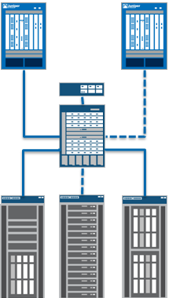
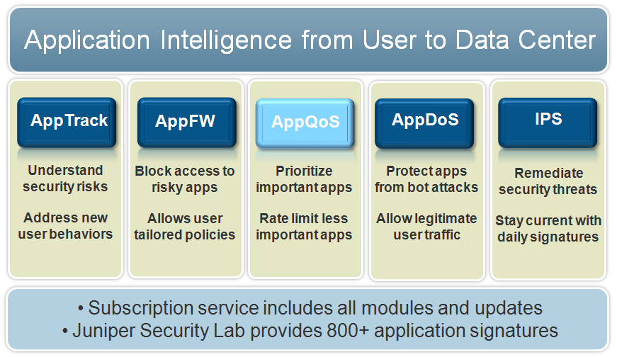


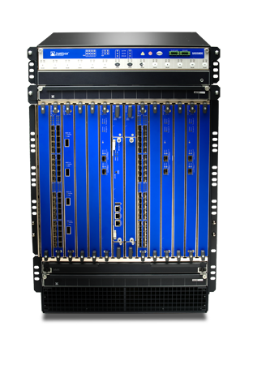
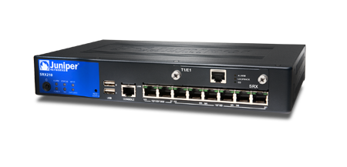
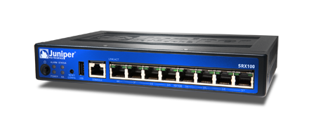
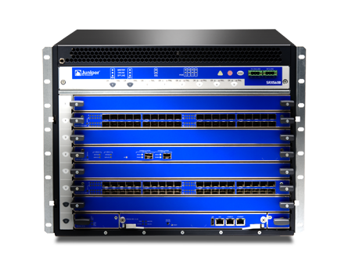
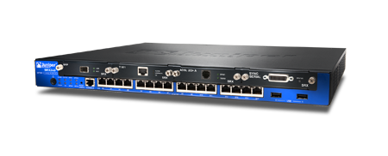
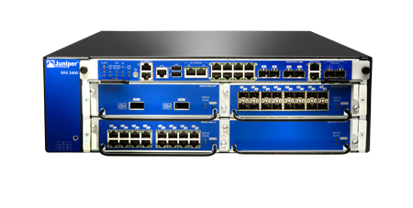
APPSECURE Next Generation Firewall overview
Intelligent software services delivers smarter FW policies on SRX gateways
Integrates application traffic control, with user control, and DoS remediation
Provides Network level visibility with correlated application and threat event tracking
Notes:
Our AppSecure approach is to build security into an underlying architecture.
AppSecure can run on existing and new high-end SRX gateways. It delivers application visibility, user policy enforcement, and security against Web 2.0 and application-borne threats.
Whether you want to understand how many of your users are accessing cloud-based applications like Facebook every day, or you need to know what applications are using the most bandwidth, AppSecure delivers powerful visibility and ongoing application tracking. With open signatures, your unique application set can be monitored, measured, and controlled to tie closely to your company’s business priorities.
Beyond just application control, it delivers sophisticated AppDoS protection, as we’ll see in a few minutes, as well as the ability to detect, track, and control nested applications. We’ll see more as we talk through use cases in a minute.
Tied in with Juniper STRM systems throughout your network, AppSecure is also very scalable for management and administration. Together with STRM, syslog information can be logged and analyzed in granular detail, to better set and enforce security policies worldwide.
And as I said, over time, we have many customers come to us feeling like single-feature boxes have left them stranded—after 12-18 months, the logging alone is slowing down a purpose-built box to the point it’s really not worth using it for the visibility they initially bought it for.
With AppSecure, you simply add a service to your powerful SRX platform, so you get both innovation and reliability from one vendor.

Slide 51

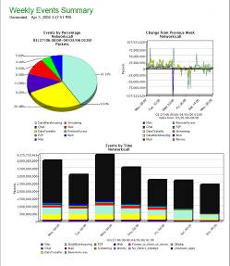
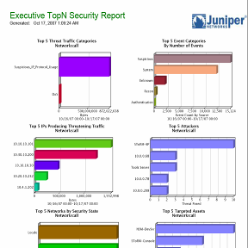
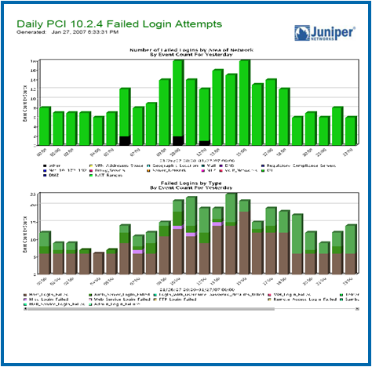
SECURITY THREAT RESPONSE MANAGER (STRM)
STRM supports SRX Series
  Intrusion Prevention System (IPS) and AppSecure
  220+ out-of-the box report templates
  Fully customizable reporting engine:
  creating, branding and scheduling delivery of reports
  Compliance reporting packages for PCI, SOX, FISMA, GLBA, and HIPAA
  Reports based on control frameworks: NIST, ISO and CoBIT
Notes:
STRM supports SRX Series
Intrusion Prevention System (IPS) and AppSecure
220+ out-of-the box report templates
Fully customizable reporting engine:
creating, branding and scheduling delivery of reports
Compliance reporting packages for PCI, SOX, FISMA, GLBA, and HIPAA
Reports based on control frameworks: NIST, ISO and CoBIT

Slide 52








Enforcing network Access policies
1
2
3
  Pulse detects device is on corporate network and
  per user policy disables any active VPN sessions
  During 802.1x authentication. MAG verifies PC meets company software and security policy requirements
  Compliance check fails. Antivirus signatures are out of date and user
  is quarantined to remediation VLAN. Patch server updates signatures.
  User is now in compliance and granted network access
✓
Active Directory
/LDAP
  SRX AppTrack feature combined with MAG data collects per user application information providing detailed reports in STRM
✓
Data
Virus SW too old
WLCs

SRX
Finance
✓
✓
EX4200 VC
Patch Remediation
✓
PC user
EX4500 VC and
EX4200 VC
6
5
4
Video
  SRX AppSecure Polices block non-work related applications
  SRX enforces user policies allowing user basic access to all servers except finance
  MAG pushes role based FW policies to EX and SRX
✓
MAG
Apps
Corporate Data Center

Internet
✓
Notes:
AJ connects his laptop to the corporate network. The Junos Pulse Client detects he is on the corporate network and automatically disables the VPN session he was running from home last night. During 802.1x authentication MAG/UAC detects that AJ’s virus definitions are too old and quarantines his PC to a remediation VLAN while his virus definitions are updated from the patch server. Now that his virus definitions are up to date he is allowed onto the network. MAG/UAC pushes FW polices/ACL’s to EX and/or SRX’s. They can both act as enforcement points if he attempts to access the finance server. Additionally, Appsecure on the SRX applies additional policies which limit A.J from accessing non-work-related applications such as Netflix and Hulu from the business network. The Apptrack management application monitors and reports that A.J.’s PC has just connected to the company e-mail system.

Slide 53

Network
SIMPLY CONNECTED
✓
Coordinated Threat Control
Wireless – scalability, simplicity, automation
Managing congestion
Simplifying the wired network
Hitless failover
Consistent security
Next – Secure Offsite Access
  6
  4
  5
  1
  3
  2
Notes:
AJ goes off to lunch. As soon as he gets to the café, he remembers that he needs to give an update on one of his projects at a 1:00 meeting. He does not have time to go back to his desk to get the information. He will have to get into the corporate database from where he is. Using Junos Pulse on his iPad, he is able to create a secure connection back to the project server and get his update information.

Slide 54






Juniper Networks Junos Pulse:
Connect, Protect and Control
SSL VPN
Full Layer 3 Tunnel
Secure Email (ActiveSync proxy)
Web VPN (browser-based apps)
On Device
Security
Antivirus & Antimalware
Block SMS & voice spam
Endpoint Firewall
AntiSpam
Monitor &
Control
Mobile Device Management
Application inventory and
control
Content monitoring
Loss & Theft
Protection
Remote lock and wipe
Backup & restore
GPS locate
SIM change notification
Notes:
To safely support a broad variety of mobile devices on your network, both personal and corporate issued, the following should be deployed to protect against today’s and tomorrow’s threats:
Secure access
Antivirus
Personal firewall
Anti-spam
Loss/theft protection
Device control
Secure access
Consistent end-user experience regardless of device (laptop, netbook, smartphone, tablet)
Consistent access policies across devices
Support for mulitifactor authentication across devices
Support for a broad range of application and traffic types, including VDI
Antivirus (detail provided if you need notes)
Real-time protection updated automatically
Scans files received over all network connections
On-demand scans of all memory or full device
Alerts on detection
Personal Firewall (detail provided if you need notes)
Inbound/Outbound Port+IP Filtering automatically
Full control of alerts/logging
Default (high/low) filtering options + customizable
Antispam (detail provided if you need notes)
Blacklist filtering – blocks voice and SMS spam
Message settings
Disable alerts for incoming messages (option)
Automatic denial for unknown or unwanted calls
Loss theft protection (detail provided if you need notes)
Remote Lock and/or Wipe
GPS Locate/Track
Device Backup/Restore
Remote Alarm/Notification
SIM Change Notification
Device monitoring (detail provided if you need notes)
Application inventory and removal
Monitor SMS, MMS, email message content
View phone call log and address book/contacts
View photos stored on device
T: This suite solves our customer’s problems like nothing else currently available in the market…
54

Slide 55



Mobile device remote network access policy and Access Control
  SRX AppTrack feature combined with MAG data collects per user application information providing detailed reports in STRM
1
2
3
  User needs to access company intranet over
  non-corporate network
  using iPad
  User starts Junos Pulse and initiates a secure VPN session with MAG appliance
  MAG verifies user login, establishes VPN and the device is allowed on the network.
✓
Active Directory
/LDAP
✓
Data
WLCs
SRX with IDP/
AppSecure

6
5
4
Finance
  SRX AppSecure polices block
  non-work related applications
  SRX enforces user policies allowing user access to all servers except finance
  MAG pushes role based ACL and FW policies to the SRX and EX
✓
EX4500 VC and
EX4200 VCs
Video
✓
MAG with Radius,
SSLVPN and UAC
modules
Apps
Corporate Data Center

Internet
✓
Wireless User
Tablet/smartphone

Slide 56
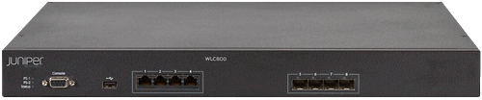
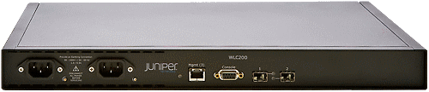
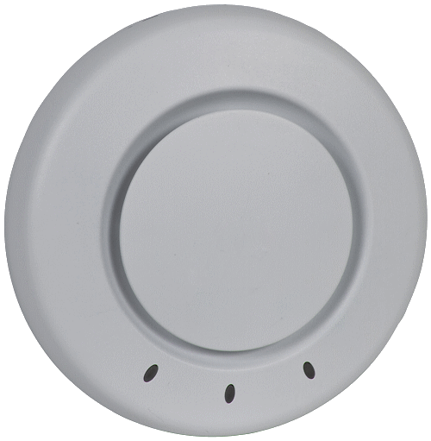

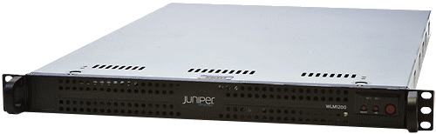







Campus branch Solution - Evolution
Today
Tomorrow
WLC & WLA product lines
Overlay Solution
RINGMASTER + Pulse + Space
Access
Manage
EX, SRX, MX product line + Junos
Integrated Solution

Slide 57
SIMPLY CONNECTED
Juniper Switching
March 14, 2012
Notes:
We’re going to be covering Simply Connected – our integrated portfolio of Enterprise products and how these address the current trends of mobility, access and security

Slide 58





EX series switches
Deployed Extensively
Over 3,000 customers, 7M ports
Data center, campus, branch, SP
Financials, Healthcare, Education
#3 LAN switching vendor
Why We Win
High performance
Carrier-class resiliency
Standards-based open architecture
  Operational Simplicity
Notes:
In just over three years, we have earned the success of over 3,000 customers. Our EX switches are being used to bring performance to all places of the network: Data Centers, Campuses, Branch, SP… And with that many customers, we are now present in pretty much every industry such as Financials, Healthcare, and Education, to name a few. And just last year, after only just two years in this market, we have reached and secured the number three position as a global LAN switching vendor with extremely reputed customers such as the New York Stock Exchange, or IBM.
Why such a success? Our Ex switches and Simply Connected solutions bring our customers high performance, carrier-class resiliency, and standards-based open architectures. In two word, this is about operational simplicity. It is about making your networks easier to manage, and more efficient, for a higher return on your investment.

Slide 59

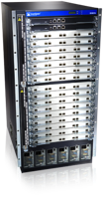






EX Series: Campus Products
 | Small Campus | Medium Campus | Large Campus
Core
Aggregation
Access
EX8208
EX8216
EX4500
EX4500
EX4200
EX8208
EX3200
EX3300
EX4200
EX2200
EX4200
EX2200-C
EX3300
EX6200
EX6200
Notes:
In the campus, our solutions now span the entire spectrum from the very small campus to the very large (over 5,000 users). And in many instances, our superior performance and technologies allow our customers to collapse together several network tiers for a better network architecture simplification, such as collapsing the access with the aggregation tiers and the aggregation with the core tiers.

Slide 60






Ex series fixed Platforms
12 port 10/100/ 1000BASE-T PoE/PoE+ Fan-less | Fixed power supply and fans 24/48 port 10/100/ 1000BASE-T 4 SFP uplinks PoE/PoE+ model options | Modular power and cooling Field replaceable power and fans 4 port GbE SFP uplink 2 port 10GbE XFP uplink External RPS option Full Class 3 PoE OSPF, IP multicast in base license | 24/48 10/100/ 1000BASE-T PoE/PoE+ Data center air flow 6 member Virtual Chassis Fixed power supply and fans MacSec  External RPS option  4 port SFP/SFP+ uplinks | 28/48 port wirespeed 10/100/ 1000BASE-T PoE/PoE+ Flexible uplinks Data center air flow Field replaceable power and cooling 4 port GbE SFP uplink 2 port 10GbE XFP uplink 10 member Virtual Chassis 128 Gbps Virtual Chassis backplane | 40 10GbE fiber ports Redundant power and cooling Small form factor 10 member Virtual Chassis Mixed Virtual Chassis with EX4200 Line rate
EX2200-C | EX2200 | EX3200 | EX3300 | EX4200 | EX4500
 Roadmap
Notes:
Our EX Series fixed platforms address a wide variety of networking needs. They are ideal for the access, as well as the aggregation, and small core tiers. Many of our EX Series fixed platforms provide you with Virtual Chassis technology. All of our Access switches now offer PoE+ (on the EX2200-C, EX2200, EX3300, and EX4200). And all share the same Junos OS, simplifying the set of instruction and the management of these switches throughout your networks.

Slide 61
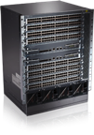

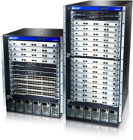







Ex series Modular Platforms
10 slot modular chassis Redundant SREs 648 port 10/100/1000BASE-T line card 48 port 10/100/1000BASE-T PoE+ line card Redundant fans 6 power supplies 4 Gbps per slot with redundant SREs | 8/16 slot modular chassis Various line card options Virtual Chassis support with XRE200 320 Gbps per slot Fully redundant Routing Engines 100GbE ready 1.92 Bpps MPLS, IPv6
EX6200 | EX8200
48x1G-ES
8x10G
48x1G
48x1G-Copper
40x10G
48x1G-PoE
48x1G-Fiber
48x1G-POE
 Roadmap
Notes:
EX Series modular platforms are designed for high-performance networks. With PoE+ line cards, both the EX6200 and EX8200 bring high-density PoE+ to the access, while the superior bandwidth of the EX8200 chassis bring future-proof performance to your networks. Our continuous investment and innovation our modular platform ensure that your investment will last and your network will stay ahead with the continuous innovations that we are bringing to these platforms.

Slide 62
SIMPLY CONNECTED
Juniper Switching – Virtual Chassis
March 14, 2012
Notes:
We’re going to be covering Simply Connected – our integrated portfolio of Enterprise products and how these address the current trends of mobility, access and security

Slide 63

Traditional campus network
Core redundant devices — Layer 3 only
  OSPF, fast convergence, ECMP
Aggregation — Layer 2/3
  Spanning Tree slow convergence, blocked links, single forwarding path
  VRRP/HSRP fast convergence single forwarding path
Access — Layer 2 only
  Spanning Tree slow
  convergence, blocked
  links, single forwarding path
  In most networks, redundancy = complexity
  L2 loops and Spanning Tree problems can be difficult to diagnose
  VRRP/HSRP require multiple device configurations to remain in sync at all times
Notes:
Typical legacy three tier network. Often the aggregation tier is unneeded, but because of poor performance from older generation networking equipment is still the primarily network design used even when it serves no real function.
The core is usually Layer 3 routing only with Layer 2 and 3 services provided at the aggregation layer
Simplify the network by eliminating dependence on the following features
Spanning tree
Can create loops that are difficult to diagnose
Loop detection can take a significant amount of time causing applications to break/restart in case of failure
Easily misconfigured
When functioning properly blocks half the links, reducing capacity. Typically when bandwidth upgrades are performed they must take into account twice the required bandwidth since half the links are shut down.
FHRP – First Hop Redundancy Protocol, this is designed to provide L3 redundancy typically in an active/standby setup. Failover times are pretty fast allowing most applications to continue operating in case of a failure. Most of these protocols result in a single link forwarding traffic. This has the same implications as spanning tree and blocked links. Complex load balancing schemes involving a static configuration of gateway per vlan is often used, but this is non-intuitive and does not result in good load sharing of traffic.
FHRP protocols are configured separately on each device and each device is an almost copy of the other devices providing FHRP services. This tends to create the opportunity for misconfigurations between devices and can be difficult to diagnose routing and forwarding problems when they occur.
VRRP – Virtual Router Redundancy Protocol (standard protocol)
Standard based way of providing Layer 3 gateway redundancy.
HSRP – Hot standby Redundancy Protocol (cisco proprietary protocol)
Cisco proprietary method of providing Layer 3 gateway redundancy.
GSLB – Global Server Load Balancing (cisco proprietary protocol)
Cisco propritary method of providing Layer 3 gateway redundancy and load balancing of up to 4 gateways.
While this does provide a method to load balance traffic between links, it still involves adding a separate protocol to manage layer 3 forwarding.
Like other FHRP protocals GSLB is configured separately on each device and each device is an almost copy of the other devices providing GSLB services. This tends to create the opportunity for misconfigurations between devices and can be difficult to diagnose routing and forwarding problems when they occur.
This feature often requires software upgrades and hardware upgrades to function properly
Multiple links should be used to connect devices. Technologies like Juniper’s Virtual Chassis allow for multiple links between devices to be connected across separate switches for redundancy, but still act like a single aggregated link or LAG. Eliminating complexities like spanning tree, FHRP or routing protocols and still provide redundancy.

Slide 64
Juniper Virtual Chassis Technology provides redundancy and simplifies the network
Core — multiple redundant devices managed as a single device
  OSPF fast convergence, ECMP
Aggregation L2/L3
  Reduced number of devices to manage, 10GbE LAG to access layer
  Simplified forwarding;
  no VRRP/HSRP,
  no Spanning Tree,
  no blocked links
Access — Layer 2 only
  Virtual Chassis can span
  multiple closets using
  10GbE links
  Juniper Virtual Chassis technology provides box-level redundancy and HA features with simplified configuration and management (redundant REs, power, network fabric, blowers)
  All links forwarding traffic, no Spanning Tree, no VRRP/HSRP
  Reduced configuration, fewer devices to manage, fewer uplinks required
Notes:
This slide illustrates how Juniper’s Virtual Chassis technology can be used to reduce the number of devices that need to be managed and allows for links to be distributed across multiple devices without the requirements of spanning tree, FHRP, routing, etc…
Virtual chassis can also span large distances allowing for multiple wiring closets to be consolidated into a single manageable device simplifying operations (see virtual chassis section of this presentation in the supporting materials for more information)

Slide 65


Ex4500/EX4200 Virtual Chassis compared to traditional modular chassis
Benefits of a Modular Chassis
High availability
  Redundant RE
  Redundant switch fabric
  Redundant power
  Redundant cooling
Easy to manage
  Single image
  Single configuration file
  One management IP address
Performance and scale
  Modular configuration
  High-capacity backplane
Additionally, Virtual Chassis offers:
  Physical placement flexibility
  Pay-as-you-grow expansion
  Lower power consumption
  Decreased heat generation
  Less consumed space
128Gbps
backplane
Route Engine
Line Card
Notes:
65

Slide 66

EX4200 Extended Virtual Chassis
Extended Virtual Chassis
Across wiring closets, data center racks or rows
Dedicated Virtual Chassis
Up to 80 km
GbE or 10GbE Virtual Chassis Extension
Virtual Chassis Location #1
Virtual Chassis Location #2
GbE or 10GbE Virtual Chassis Extension
Extend height and/or width of Virtual Chassis by GbE or 10GbE uplinks
  Up to distance of optics (80km)
  Maximum circumference of 100km
Notes:
66

Slide 67
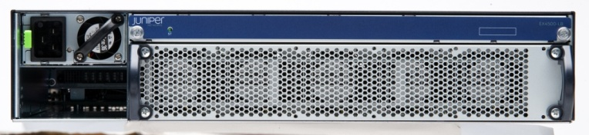
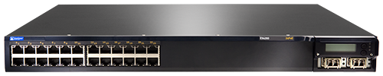


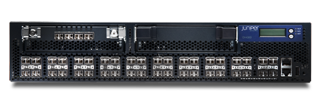
EX4200 & EX4500 VIRTUAL CHASSIS
EX4500
64 Gbps per Virtual Chassis port
EX4200
EX4200 and EX4500 Virtual Chassis
Same Hardware up to 2 EX4500’s or 10 EX4200s
Mixed Hardware 2 EX4500s, and up to 8 EX4200s (total cannot exceed 10)*
Up to 480 GbE ports
Up to 112 10GbE ports
Backplane: 128 Gbps
*when EX4500 and EX4200’s are combined 2 EX4500’s are required to provide redundancy
Notes:
67
67

Slide 68

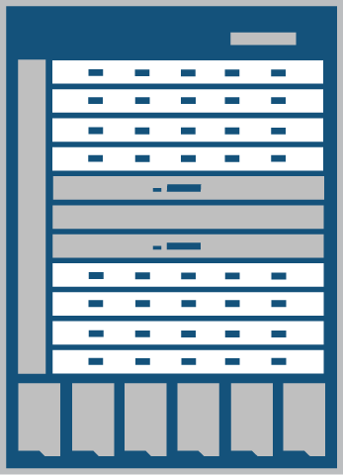
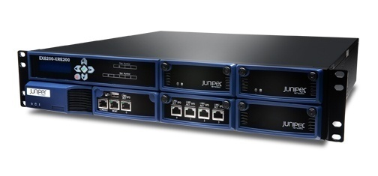
EX8200 VIRTUAL CHASSIS TECHNOLOGY
Extends Virtual Chassis technology
to the core
Simplifies the architecture
  Eliminates Spanning Tree and VRRP
  Reduces the number of logical devices
Enables large core and access
  Two-member Virtual Chassis
  Over 1200 10GbE ports per logical device
  Over 1400 GbE per logical device
  Extend the Virtual Chassis to 80km
Most available single control plane implementation
  No single point of failure
  Control plane offload to external route engine
Active XRE
Standby XRE
EX8200 Virtual
Chassis Switch
2x10GE LAG
2x10GE LAG
XRE200
Notes:
68

Slide 69
distributed switching
Master
Backup
A
Local Switching
B
C
Inter-Module Switching
D
Notes:
Let’s now look at two examples of how packet switching works on a virtual chassis.
Consider this 10 member mixed virtual chassis with two EX4500s and eight EX4200s.
The links in orange are the high speed 64Gbps Virtual Chassis Interconnects that we call as VCP Links
First, Local Switching – is used when the traffic needs to be forwarded across destinations reachable via the same member VC switch port. It doesn’t need to traverse across the RE. And A to B in this case.
And Secondly, Inter-module switching – if the traffic needs to flow between two destinations that are connected across two different member Virtual Chassis member switches. The traffic flows across the VCP link between the VC Member switches. With 128 Gbps backplane capacity on each member switch, we are able to achieve forwarding with No HOLB. C to D in this case.

Slide 70

Fewer managed devices
Seamless Connectivity
Consistent Security
Manageability
2,000 employee campus
5 buildings
400 user ports/building
4 floors/building
Core
80% fewer
managed devices
Aggregation
Access
Bldg 1
Bldg 5
50
5
Managed Access Switches
62
17
12
11
10
Total Managed Switches
Managed Aggregation Switches
5
2
Managed Core Switches
1

Slide 71
EX Virtual chassis compatibility and features matrix
Model | Max # | Via 10GbE | Via VCP | Mix
EX3300 | 6 | Yes | No | No
EX4200 | 10 | Yes | Yes | EX4500
EX4500 | 2/10* | Yes | Yes | EX4200
EX8200 | 2/4** | Yes | No | 8208/8216
* EX4500 VC currently only supports 2 EX4500’s in a VC
EX4500/EX4200VC supports up to 2 EX4500’s and eight EX4200’s
In the same chassis.
** EX8200 VC supports two EX8200’s in the same VC
In 12.1 up to 4 EX8200’s can be in the same VC

Slide 72
Juniper virtual chassis differentiators
Cross Platform
  Virtual Chassis technology available on EX3300, EX4200, EX4500 and EX8200 platforms
  Can mix-and-match EX4200 and EX4500 in same Virtual Chassis
    Allows for a mix of high-density 1GbE and 10GbE in same Virtual Chassis configuration
  Up to two EX8200 switches in a Virtual Chassis configuration
    Mix and match of EX8208 and EX8216 is allowed
  Up to six EX3300 switches in a Virtual Chassis
Flexible
  EX3300 or EX4200/EX4500 can use high-speed Virtual Chassis cable in same closet; 1GbE/10GbE uplinks to extend Virtual Chassis up to 80km
  EX8200 supports Virtual Chassis via multiple 10GbE LAG ports and up to 80km between devices

Slide 73
Simply Connected Demo

Slide 74


Onboarding guest users
4
  SmartPass sends temporary credential to end user via Clickatell SMS service
3
  User selects SmartPass self-registration and creates a temporary user credential
1
Clickatell SMS Gateway service
  Unknown device connects to open captive portal SSID
2
  User session is captured and redirected to SmartPass
WLC
✓
SmartPass
Wireless User
Tablet/smartphone
AP
EX Series
5
EX Series
  User uses temporary credentials to authenticate against SmartPass
6
  User is connected to the network using mobile phone number and temporary password

Slide 75

Onboarding employee owned mobile devices
3
1
  SmartPass web portal presents captive portal and redirects client to provisioning portal
  Unknown device connects to open captive portal SSID
2
  User session is captured and redirected to SmartPass
SmartPass
WLC
✓
UAC
4
Wireless User
Tablet/smartphone
AP
EX Series
  Provisioing portal pushes native supplicant config wizard to client device
EX Series
6
AD/Certificate Authority
  Provisioning wizard gets EAP-TLS configuration profile (and cert) from provisioning portal; agent disolves
5
7
  Provisioning portal gets user credentials from wizard; validates against AD; and requests user cert for end user
  User selects secure wireless network and device authenticates to RADIUS without requiring user to enter credentials
SmartPass Connect
Corporate Data Center

Slide 76

Provisioning corporate owned mobile devices
1
  Device completes registration with MSS and downloads wireless iOS profile via MDM profile (user is still connected to open SSID)
3
  Device installs profile and acquires user cert from Corp Certificate Authority via SCEP enrollment process
WLC
W2K8 Certificate Server
✓
Wireless User
Tablet/smartphone
AP
EX Series
2
EX Series
UAC
  Wireless profile contains: 1) WiFi EAP-TLS settings (certificate based auth) 2) SCEP profile for device to enroll for new certitifacate 3) CA cert to use for server validation
4
Corporate Data Center
5
  User connects to secure SSID and authenticates to RADIUS using certificate
  User is now connected to secure SSID with no user input of credentials required
Mobile Security Suite

Slide 77
Enforcing a “no BYOD” policy with device profiling
3
  Device type policy is configured to restrict iPads; WLA holds device traffic for inspection
1
  Mobile device connects to secure wireless network
4
  WLA sends device type info to WLC for matching against policy
WLC
✓
UAC
Android
Tablet/smartphone
AP
EX Series
EX Series
5
2
  User dot1x authenticates to wireless network
  Device is determined to be an Android device and is allowed on the network

Slide 78




Network Segregation and Application filtering for BYOD devices
  SRX AppTrack feature combined with MAG data collects per user application information providing detailed reports in STRM
1
2
✓
  Device authenticated on wireless network
  DHCP Server/Smartpass communicates User and IP information to UAC via IF-MAP
Active Directory /LDAP
✓
WLC
Data
SRX

Finance
✓
Wireless User
Tablet/smartphone
AP
EX Series
Video
DHCP and IF-MAP
✓
5
4
3
Apps
  SRX AppSecure Polices block non-work related applications like Hulu and Netflix
  SRX enforces user policies allowing user basic access to all servers except finance
  UAC pushes role based ACL and FW policies to EX and SRX
UAC
Corporate Data Center

Internet
✓
Notes:
Key points – Juniper provides a complete set of wireless, Ethernet and security products to easily manage multiple devices per user. The same access policy is applied irrespective of the number of devices and it is specific to A.J.
In order for A.J. to connect to the VoIP and video websites, he will have to have both sessions authenticated and access via the wireless network. Let’s take a look at the functional blocks involved.
We start by having both the phone and iPad authenticate to the AP using 802.1x. The AP then passes this information about A.J. to the wireless LAN controller . The WLC sends the request to the UAC/MAG for Radius authentication. After the authentication is verified, the information is sent to the LDAP for registration/validation and then it is passed back to the WLC. The WLC notes the new policy and send the access approval back to the AP. The AP sets the policies determined for A.J. Then it passes the IP addresses assigned down to the phone and iPad. Step one is complete. A.J. is authenticated for access on the company network.

Slide 79
Enforcing network Access policies
1
2
3
  Pulse detects device is on corporate network and
  per user policy disables any active VPN sessions
  During 802.1x authentication. MAG verifies PC meets company software and security policy requirements
  Compliance check fails. Antivirus signatures are out of date and user
  is quarantined to remediation VLAN. Patch server updates signatures.
  User is now in compliance and granted network access
✓
Active Directory
/LDAP
  SRX AppTrack feature combined with MAG data collects per user application information providing detailed reports in STRM
✓
Data
Virus SW too old
WLCs

SRX
Finance
✓
✓
EX4200 VC
Patch Remediation
✓
PC user
EX4500 VC and
EX4200 VC
6
5
4
Video
  SRX AppSecure Polices block non-work related applications
  SRX enforces user policies allowing user basic access to all servers except finance
  MAG pushes role based FW policies to EX and SRX
✓
MAG
Apps
Corporate Data Center

Internet
✓
Notes:
AJ connects his laptop to the corporate network. The Junos Pulse Client detects he is on the corporate network and automatically disables the VPN session he was running from home last night. During 802.1x authentication MAG/UAC detects that AJ’s virus definitions are too old and quarantines his PC to a remediation VLAN while his virus definitions are updated from the patch server. Now that his virus definitions are up to date he is allowed onto the network. MAG/UAC pushes FW polices/ACL’s to EX and/or SRX’s. They can both act as enforcement points if he attempts to access the finance server. Additionally, Appsecure on the SRX applies additional policies which limit A.J from accessing non-work-related applications such as Netflix and Hulu from the business network. The Apptrack management application monitors and reports that A.J.’s PC has just connected to the company e-mail system.

Slide 80
Pulse MSS Device Registration
4
3
1
  Post-auth, SmartPass redirects Pulse Agent on iOS device to Device Identity Server
  SmartPass web portal authenticates corporate user against internal identity store (not shown)
  Unknown iOS device connects to open captive portal SSID
2
  User session is captured and redirected to SmartPass
WLC
✓
SmartPass
Device Identity Server*
Wireless User
Tablet/smartphone
AP
EX Series
5
EX Series
  Device Identity Server learns device info from Pulse agent and automatically registers device with MSS
6
Corporate Data Center
  Pulse agent is redirected to MSS system and completes registration
Mobile Security Suite
*Note: Device Identity Server is logical, not necessarily a separate box

